Slide 1
Quality Attributes

Slide 2
First, let’s take a step back
Architecturally Significant Requirement (ASR): A requirement that will have a profound effect on the architecture – that is the architecture may be significantly different in the absence of this requirement.
ASRs, often, but not always, take the form of quality attributes requirements – the performance, security, modifiability, availability, usability, that the architect must provide the system.
Quality Attribute: A measurable or testable property of a system that is used to indicate how well the system satisfies the needs of its stakeholders.

Slide 3
Quality Attributes – Master List
Operational categories
  Availability
  Interoperability
  Reliability
  Usability
  Performance
  Deployability
  Scalability
  Monitorability
  Mobility
  Compatibility
  Security
  Safety
Developmental categories
  Modifiability
  Variability
  Supportability
  Testability
  Maintainability
  Portability
  Localizability
  Development distributability
  Buildability

Slide 4
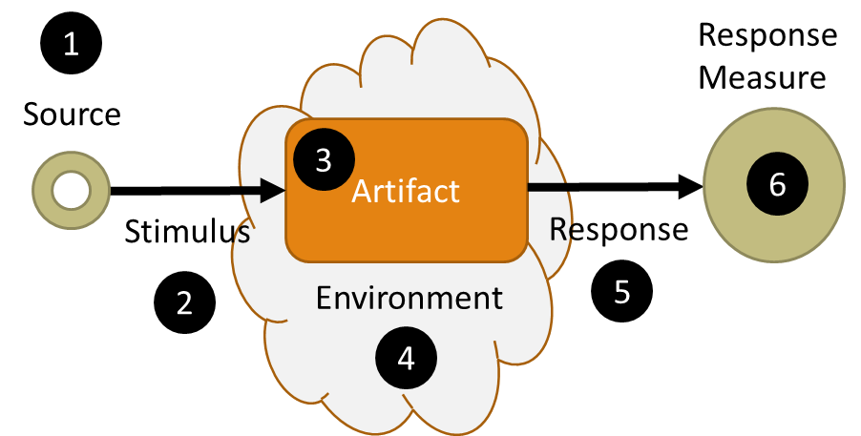
Quality Attribute Scenario
A means of specifying quality attributes requirements
1) The source of the stimulus
2) The stimulus, an event,
user operation, attack, etc.
3) The target of the stimulus
4) The set of circumstances in which the scenario takes place
5) The activity that occurs as the result of the stimulus
6) A measurement of the response

Slide 5

Example: Help Desk Usability Scenario
The user will be able to submit a request in 2 minutes.
Source: User
Stimulus: Push Help Request button
Environment: Normal Operations
Artifact: Help System
Response: Fully completed and submitted help request
Response Measure: Less than 2 minutes from retrieving help request form to submission

Slide 6
Example: Video Streaming Scenario
Real time object detection in a video stream
Source: Web Camera
Stimulus: Input video steam
Environment: Normal Operations
Artifact: Video processing software
Response: Video stream with overlaid object information
Response Measure: No delays or pauses in video stream with input rate of 60 fps
What dependencies / constraints / assumptions to you need to know to evaluate this scenario?

Slide 7
Example: Batch Processing Performance Scenario
Under normal operating conditions, when the batch process starts, 2 million bank statements are read, processed, and sent to the signing provider in at most one hour.
Source: Timer /Cron Job
Stimulus: Start Processing Event
Environment: Normal Operations
Artifact: Batch Processing Coordinator
Response: 2 million bank statements processed and sent to signing provider
Response Measure: Completes in 1 hour or less

Slide 8
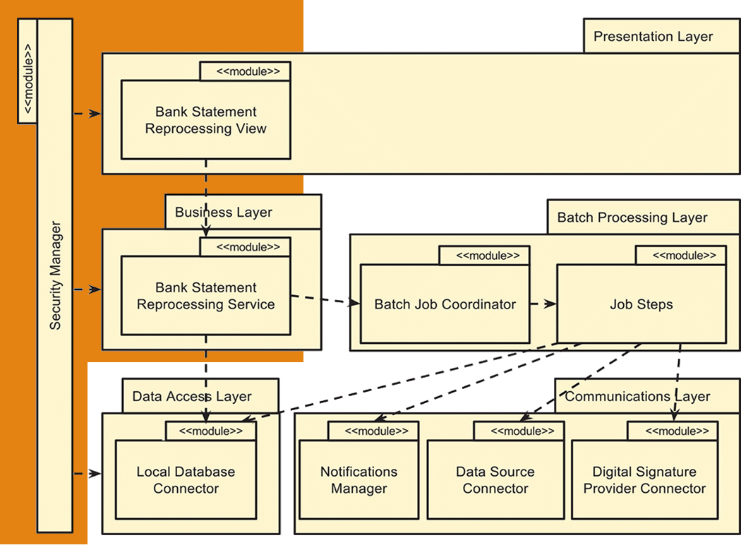
Bank System
We have one hour to process 2 million statements.
  How does that break down?
    How many statements per batch?
    How do we allocate time to each step?
      Which steps are bottlenecks?
    Do we need parallel processing?
    How does increased complexity effect our error recovery strategy?
  Read from database
  Processing
  Validation
  Submission to Signing Provider

Slide 9
Quality Attribute Scenario
A means of specifying quality attributes requirements
1) The source of the stimulus
2) The stimulus, an event,
user operation, attack, etc.
3) The target of the stimulus
4) The set of circumstances in which the scenario takes place
5) The activity that occurs as the result of the stimulus
6) A measurement of the response

Slide 10
Achieving Quality Attributes
Two general approaches:
  Design Tactics
  Architectural Patterns
  Each of these represents a decision – system designs (architectures) are a collection of decisions

Slide 11
Design Tactics
  Provide a way of making design and analysis more systematic
  Provide a systematic means for augmenting an existing pattern
  If no pattern exists, tactics allow constructing a design fragment from “first principles”
Tactics to Control Response
Change
Arrives
Changes made within time and budget
Modifiability Tactic

Slide 12
Example:
The System will be available 99.0% of the time.
Availability Tactics keep faults from becoming failures or bound the effects of the fault and make repair possible.
  Availability:
To achieve our availability requirements we need to detect faults within 1 second of occurrence and address them within 59 seconds.
Tactics to Control Response
Fault
Fault masked, prevented, or repair made

Slide 13
Patterns
Work on software patterns stemmed from work on patterns for building architecture carried out by Christopher Alexander (A Pattern Language: Towns, Buildings, Construction (1977))
    … the farmer is able to make a new barn, unlike ones which he has seen before, by taking all the patterns he knows, for barns, and combining them in a new way.
All well-structured software systems are full of patterns
  Architectural patterns – system level structural organization
  Design patterns – component level design
  Programming idioms – reoccurring constructs expressed in different languages (programming tasks, algorithms, data structures; e.g., increment counter)

Slide 14
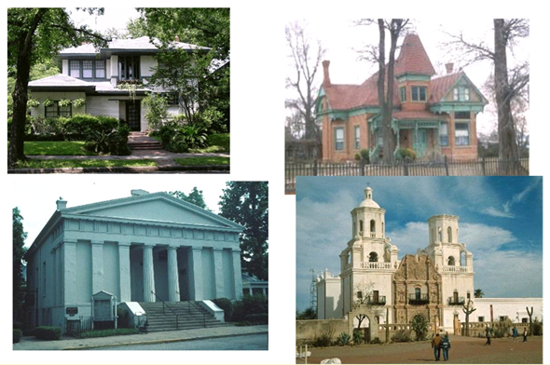
Architectural Styles (Patterns)

Slide 15
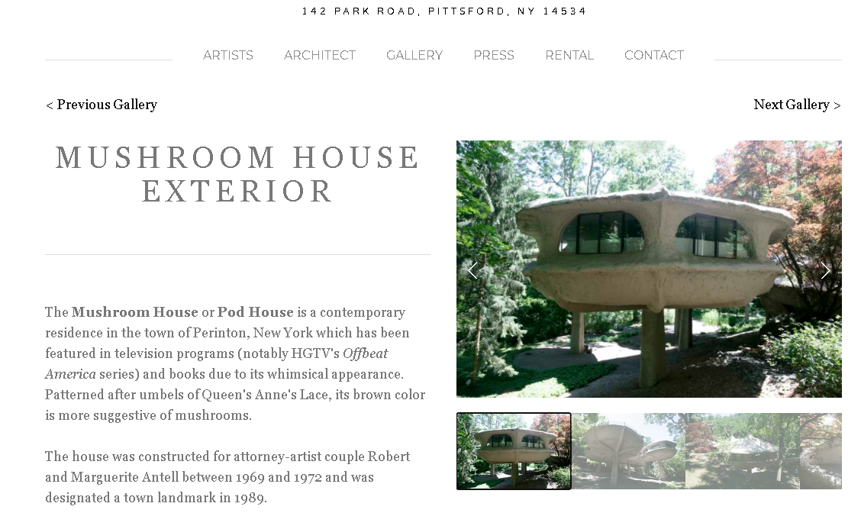
http://www.mushroomhouse.com/mushroom-house-exterior

Slide 16
An Architectural Pattern…
  Is a package of design decisions that is found repeatedly in practice
  Has known properties that permit reuse
  Describes a class of architectures

Slide 17
What is a Software Architectural Pattern?
A pattern is a solution to a problem in a context
  Context. A recurring, common situation in the world that gives rise to a problem.
  Problem. The problem, appropriately generalized, that arises in the given context.
  A solution. A successful architectural resolution to the problem, appropriately abstracted
An architectural pattern expresses a fundamental structural organization abstraction for software systems
  A set of structural elements
  Their relationships
  Rules and guidelines for organizing the relationships between them

Slide 18
Software Architecture Patterns
Versus software design patterns – higher level system wide in scope; some overlap
  Recall the distinction between architecture and design work
Most software systems cannot be structured according to a single architectural pattern
  Example: Design a system for flexibility of component distribution in a heterogeneous computer network and for adaptability of their user interfaces
How do you think about software design? Essentially the same cognitive process for architecture design …
  Requirements driven, separation of concerns, top-down, apply patterns

Slide 19
Describing a Pattern Solution
A pattern solution is determined and described by:
  A set of element types (for example, data repositories, processes, and objects)
  A set of interaction mechanisms or connectors (for example, method calls, events, or message bus)
  A topological layout of the components
  A set of semantic constraints covering topology, element behavior, and interaction mechanisms
  I.e., views
Organize patterns by predominant structure – module, connector, allocation

Slide 20
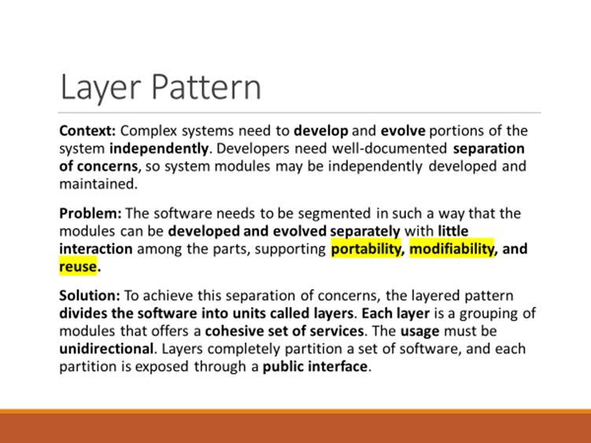
Patterns and Quality Attributes
Patterns: Packaged strategies for solving some of the problems facing a system
A pattern typically packages multiple design decisions into a single package. In other words, a packages generally address multiple Quality Attributes and ASRs.

Slide 21
Relationships Between Tactics and Patterns
A pattern is a high level structural design choice
A tactic is a lower level design decision to achieve a QA response
Patterns are built from tactics; if a pattern is a crystal, a tactic is a molecule or an atom.
For example the layered pattern utilizes the tactics:
  Increase semantic coherence
  Encapsulation
  Abstract common services
  Restrict communication paths
  Use an intermediary
All of which are methods of achieving the Quality Attribute Modifiability

